Slide 1
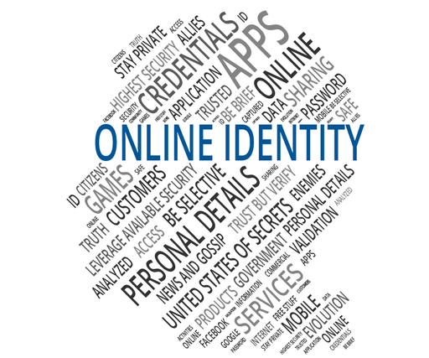
How Real is your online personality?
“An analytical survey exploring the difference between online and real-life personalities.”
This research aims to analyze how digital behavior reflects — or reshapes — one’s true identity.

Slide 2
A Brief Introduction
In today’s digital era, social media has become a stage where people carefully shape how they are seen by others. This presentation explores the differences between individuals’ real-life personalities and the versions they present online. Through survey data and analysis, it aims to understand how authenticity, self-expression, and social pressure influence our digital identities. Ultimately, this study seeks to uncover how “real” our online selves truly are.

Slide 3
Survey Methodology
This survey was conducted to gather insights from a diverse group of participants representing different age groups, professions, and backgrounds. Responses were collected through a Google Form distributed online, ensuring accessibility and convenience for all respondents. The questionnaire included a mix of multiple-choice and opinion-based questions designed to evaluate how individuals express their personalities in digital spaces. Both male and female participants contributed to the study, providing a balanced perspective on the authenticity of online behavior and self-representation.

Slide 4
📉Survey Questions and Responses
Questions | Responses
How often do you post content online? | About half of the respondents (52%) post content sometimes.
2. When posting online, how often do you edit or filter your content? | The majority of respondents (around 80%) edit or filter their content before posting.
3. How similar is your online personality to your real- life personality? | About equal portions of respondents (43%) said their online personality is similar or somewhat similar to their real- life.
4. Do you feel more confident online than in real life? | The majority of people replied that they feel more confident online than in real life.
5. Do you think people judge others based on their online personality? | Almost half people(45.5%) think people judge others, while others were unsure about it.

Slide 5
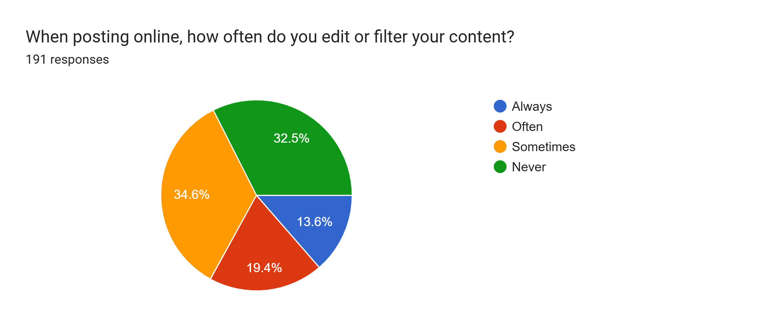
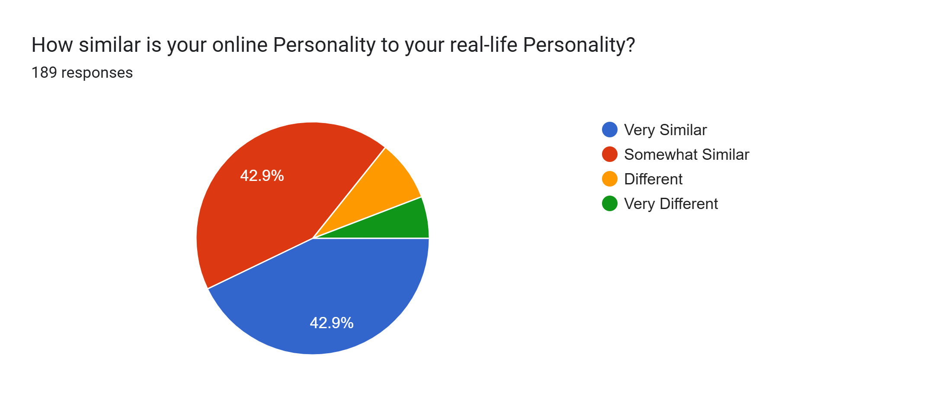
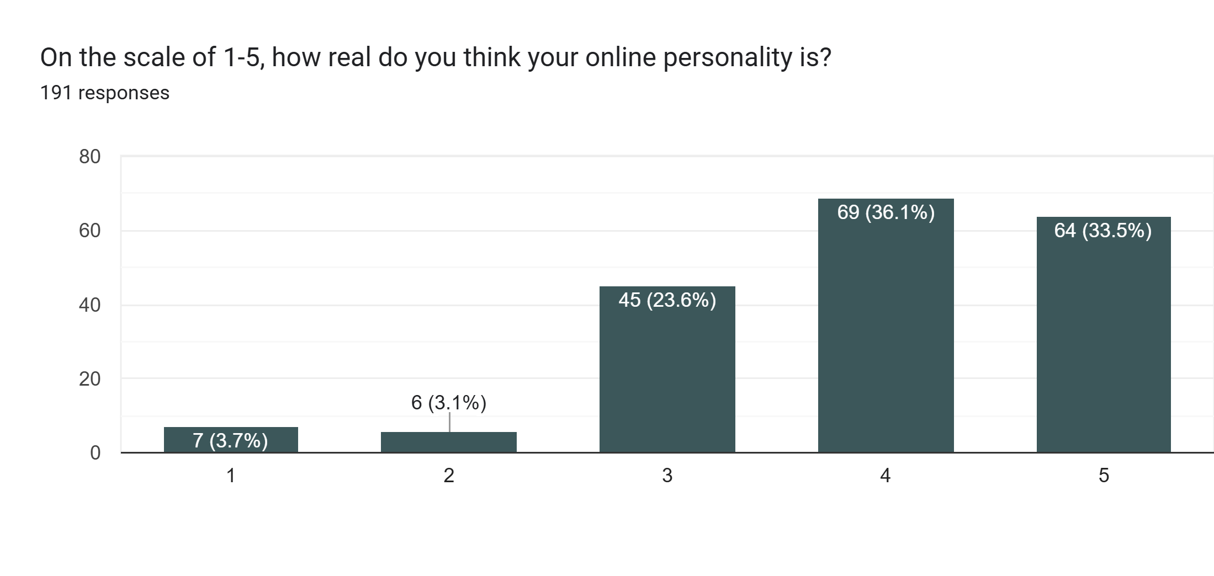
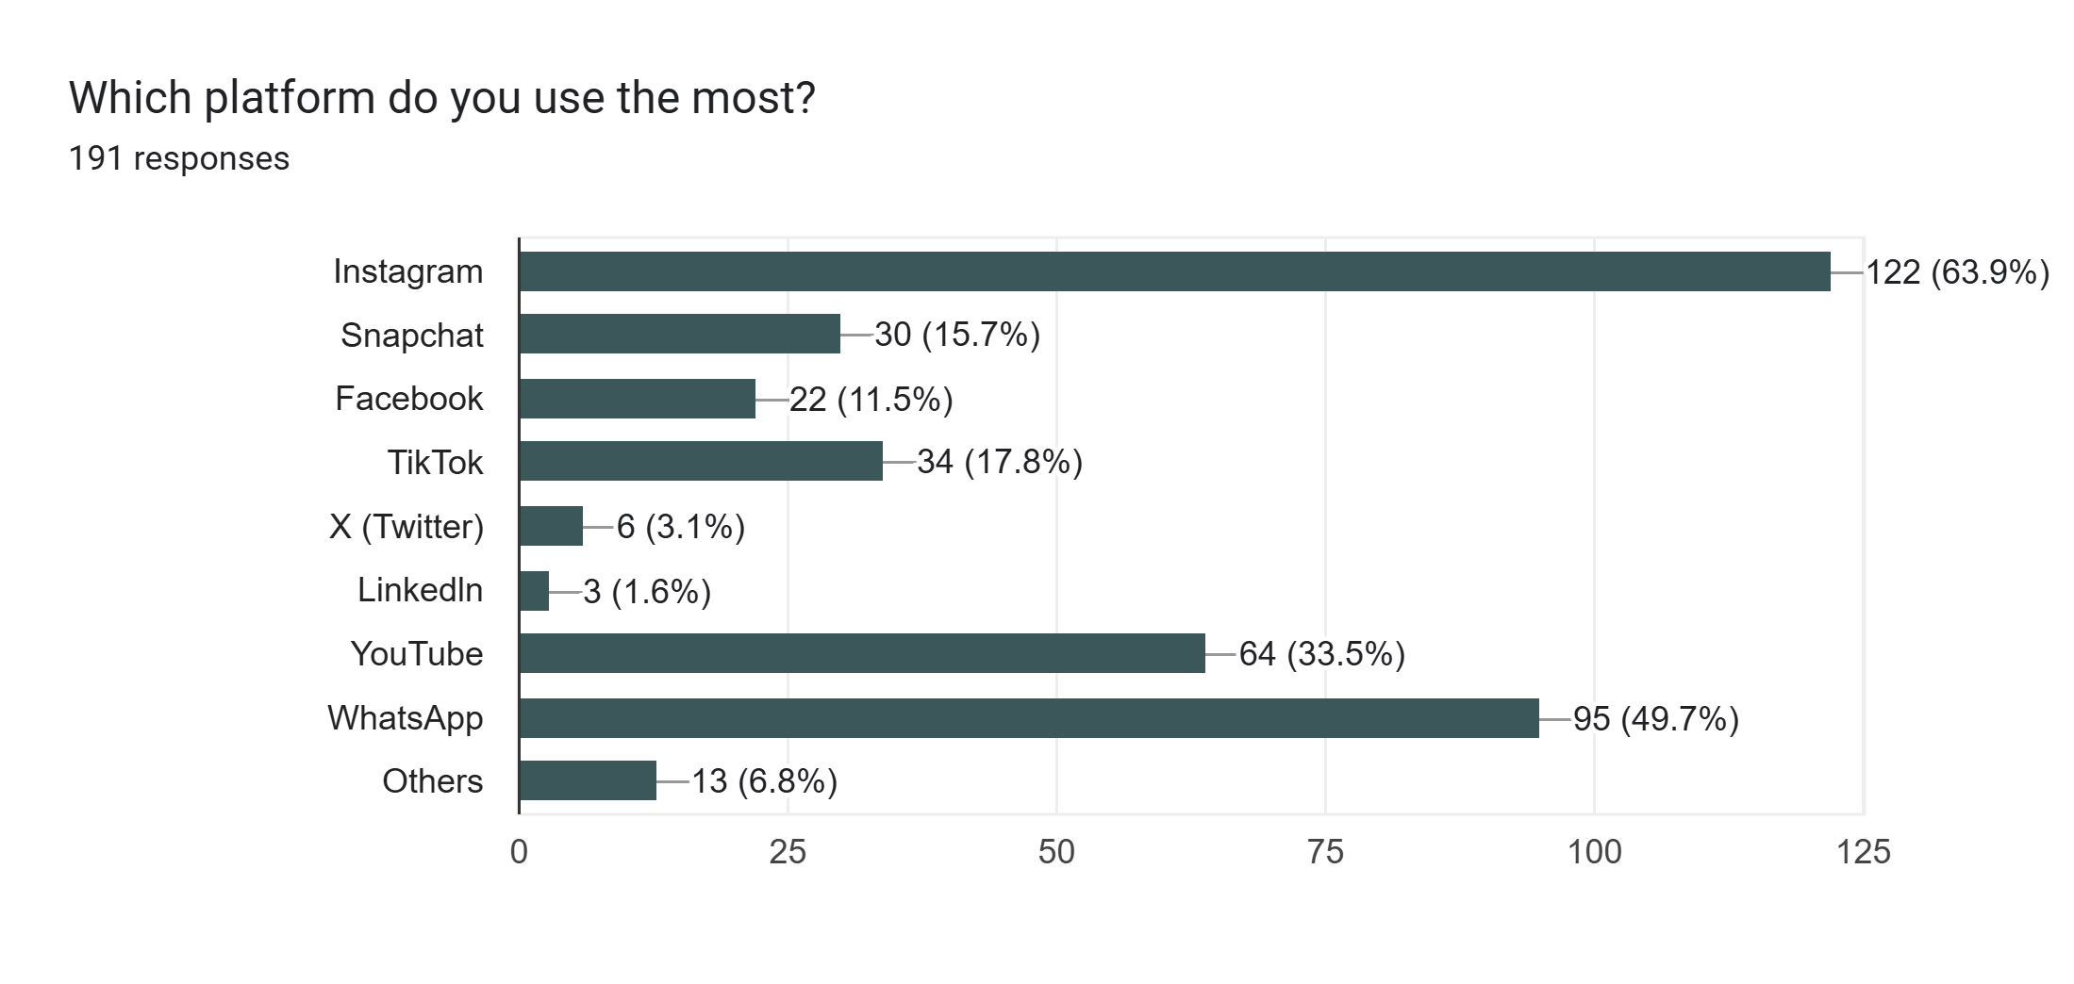
📊 Graphic Representation

Slide 6
📜Analysis / Interpretation
The survey results show that most people don’t present their full, real selves online. Many participants admitted that they sometimes edit their posts or act differently to appear more confident or likable. This suggests that social media often becomes a space where people show their “best version” instead of their real personality.
At the same time, some participants said that being online gives them freedom to express thoughts they can’t share in person. So, while the internet can create fake impressions, it can also help people show hidden sides of who they are.

Slide 7
🏷️Conclusion
The survey shows that people often present a slightly different version of themselves online. While some try to appear more confident or positive, others use the internet to express parts of their true personality that they hide in real life. In the end, our online personality is real — but only a part of the whole picture.

